Slide 1
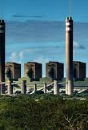

Invest in Lephalale
Local Economic Development
Lephalale Local Municipality

Slide 2

Executive Overview
Strategic investment destination in the Waterberg District
Energy, mining, agriculture and diversification hub
Strong alignment to Just Energy Transition priorities
Pro-investment local government support

Slide 3

Why Invest in Lephalale
Strategic location and infrastructure
Diverse and scalable investment opportunities
Supportive local government
Partner in South Africa’s energy future

Slide 4
Strategic Location & Infrastructure
Located in Limpopo’s Waterberg District
Anchor of national energy generation
Access to road, rail and bulk infrastructure
Proximity to regional and national markets

Slide 5
Economic Overview
Mining and energy-led economy
Growing agriculture and agro-processing sector
Emerging green and circular economy
Strong potential for diversification

Slide 6
Priority Growth Sectors
Renewable Energy and Just Energy Transition
Mining and Mineral Beneficiation
Agriculture and Agro-processing
Circular and Green Economy
Tourism and Hospitality

Slide 7
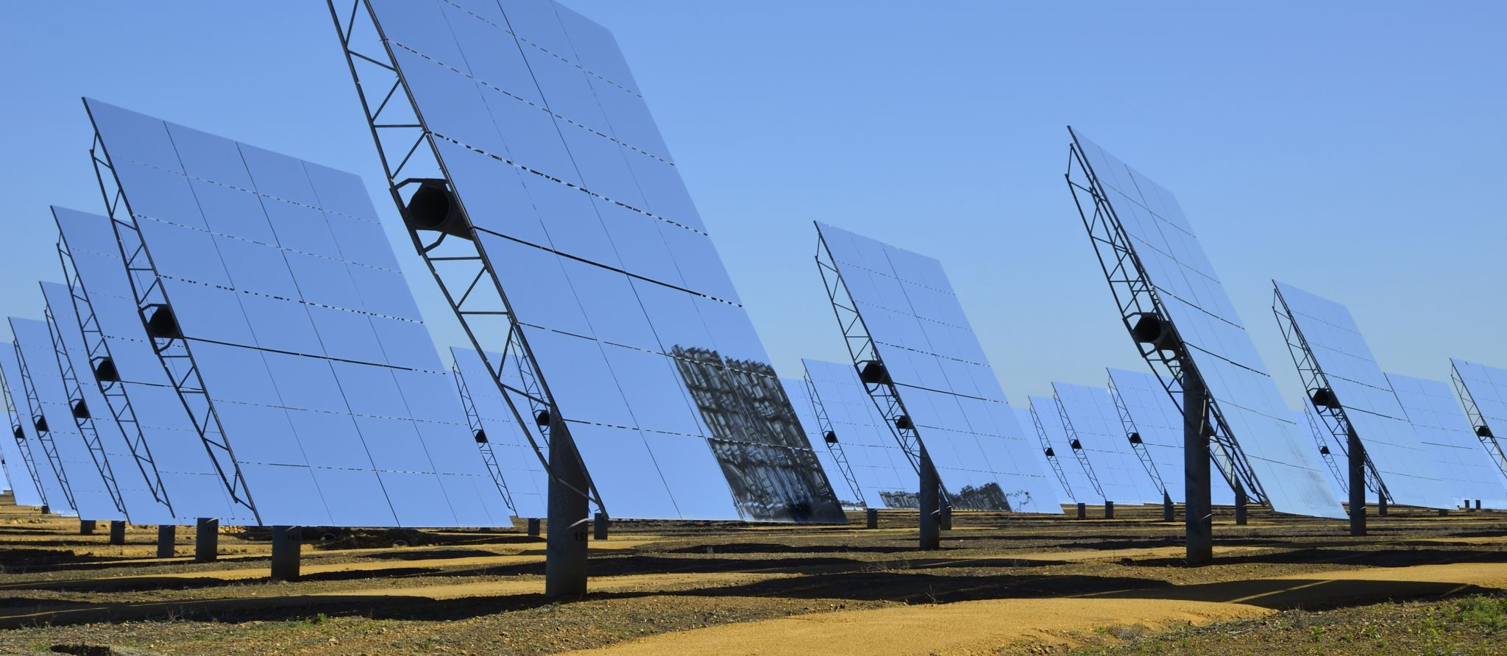
Just Energy Transition Opportunities
Solar PV and energy storage projects
Grid-ready energy infrastructure
Skills reskilling and green jobs
Community-inclusive transition programmes

Slide 8
Catalytic Investment Opportunities
Renewable Energy Parks
Agro-processing facilities
Industrial and logistics developments
Recycling and waste beneficiation hubs

Slide 9
Enabling Business Environment
LED-led investment facilitation
Alignment with IDP, LED Strategy and National, Provincial District Plans
Public–Private Partnership opportunities
One-stop investor support

Slide 10
Key Economic Stakeholders
Mining and energy companies
Agricultural producers and associations
Development finance institutions
Government and community partners

